Slide 1






Transformational Collaborative Outcomes Management and the Nevada CANS 2.0
General Session Orientation and Overview
Amy Guevara, Psy.D.
Karen Chandler, MFT
Erica Smith, LCPC

Slide 2
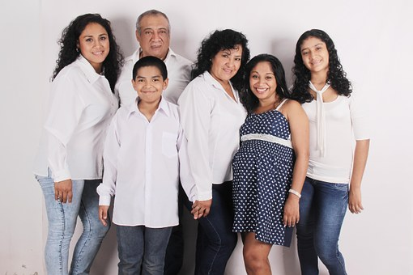
TCOM and the CANS • Agenda
9:00 Welcome and Introduction
9:30 TCOM Philosophy and Framework
10:20 Nevada Context
10:30 Break
10:40 Communimetrics and the 6 Key Principles 11:30 NV CANS Domains and Items
12:00 Lunch Break
1:00 NV-CANS 2.0: Domains and Items, continued
2:30 Practice Vignette
3:15 Break
3:25 Review of Preferred Ratings
4:00 Adjourn
Notes:
Walk out song; use introduction from training certification
Team Agreement, arguing about 0 and 1’s which is irrelevant; 1 off preferred rating is not a problem; don’t let them argue
Who is excited to add more paperwork, raise hand, good, cuz that not what the CANS is/does

Slide 3

Getting to Know Each Other
Poll: Have you ever used the CANS?
Name, Organization, Role
What have you heard about the CANS?
Questions or concerns about the CANS you would like addressed?
Hopes for the Day?
Notes:
We are using the CHAT box, asking people to put their answers in the chat box

Slide 4
Tcom and the cans
The Role of Outcomes Management
Notes:
Transformational Collaborative Outcome Management is a philosophy or practical framework used to navigate complex systems.
When TCOM is used to guide our work, we can create and communicate a shared vision that is about the wellbeing of our children and families.
CANS aims to be more than an assessment tool. It communicates, collaborates, coordinates and provides for accountability at the individual, provider and administrative levels.
Exercise: Ask people to unmute or use the chat box
What do you like about your job? Dislike?
What do you like about working in complex systems? What do you dislike?
move it along so people aren’t sharing the same things, do you have anything different
Let’s see how your likes and dislikes compare with TCOM philosophy

Slide 5
A Philosophy from Which Change Can Grow
Transformational: Our work is focused on personal change.
Collaborative: We must develop a shared understanding and vision.
Outcomes: What we measure impacts the decisions we make about the strategies and interventions we use.
Management: Information gathered is used in all aspects of
managing the system from planning for individuals and
families, to supervision, and program/
system operations.
t
o
c
m
Notes:
The TCOM approach is grounded in the concept that the various perspectives in a complex system are often at odds.
Core Concepts of Transformational Management:
First, The system should be focused on personal change. TCOM IS NOT a service system. A service system focuses on spending time with people. Whereas TCOM’s work is intended to be transformational—helping people change their lives.
Second, We need to create and communicate a shared vision that is about the wellbeing of our children and their families. The Shared vision has to involve the participation of all key partners in order to ensure trust.
Next, We need to use that information in order to make good decisions that have an impact. Service systems would rather spend time and space with the youth).
Finally, The information or story we collect must be used at all levels of the system to ensure that we are working towards the same goals.
AUDIENCE PARTICIPATION:
Can you think of examples when a transformational approach has been successful?
Can you think of examples of when there has been a barrier to a transformational approach?

Slide 6
TCOM Guiding Values
  All assessments and interventions should be culturally responsive and respectful.
  People should have voice and choice regarding their participation in any assessments and interventions.
  All interventions should be personalized, respectful and have demonstrable value to the people they serve.
t
o
c
m
Notes:
Transformational Collaborative Outcomes Management helps connect all involved systems in order to better serve our consumers and return to the shared vision. Examples of system partners include a Mental health therapist, Judge, Social Support, Family Doctor, Client and Family, School etc.
With the focus of our work is to build consensus, the approach we use are guiding values to frame the “ground rules” for our engagement with one another. With that approach,
All assessments and interventions should be culturally responsive and respectful.
People should have voice and choice regarding their participation in any assessments and interventions.
All interventions should be customized, respectful and have value to the people we serve. (values continue on the next slide)

Slide 7
TCOM Guiding Values
  Collaborative processes, inclusive of children and families, should be used for all decisions at all levels of the system.
  Consensus on action is the primary outcome of collaborative processes.
  Information about the people served and their personal change should always inform decision making all levels of the system.
t
o
c
m
Notes:
Collaborative processes, inclusive of children and families, should be used for all decisions at all levels of the system.
Consensus on action is the primary outcome of collaborative processes.
Information about the people served and their personal change should always inform decision making at all levels of the system.
With these ground rules in action, we are better able to effectively realize the communimetrics vision.

Slide 8

Transformational Change
Think about your program. What does transformational change look like for the children, youth and families that you serve?
Notes:
Brainstorm – could be large group (put in the chat box) or small groups (put in breakouts)
that report out, based on size of group and timing for the day’s agenda.

Slide 9
Understanding a Young Person’s Story
01
03
02
04
The young person shares their story.
The care provider listens to their story.
The other story tellers share their perspectives.
The stories are combined, and a single narrative is agreed upon.
Notes:
With TCOM and the CANS we call it collecting a person’s story or their personal narrative.
Sometimes the person doing the initial interview is also the clinician(s) providing treatment. However, often the person or family’s story is then shared with the program or clinician who will provide treatment. This sharing of the story is critical so that people and families are not expected to retell their stories multiple times just to get help.

Slide 10

What is the CANS?
The Child and Adolescent Needs and Strengths (CANS) is a tool that summarizes the information gathered through an assessment process. The CANS is an information integration tool that is used to identify the needs and strengths of children/youth and their families. The goal of the CANS is the transformational change of children/youth and their families.
Notes:
The Child and Adolescent Needs and Strengths (CANS) is a tool that summarizes the information gathered through an assessment process.
The CANS is an information integration tool that is used to identify the needs and strengths of children/youth and their families. The goal of the CANS is for transformational change of children/youth and their families.
The CANS is a summary tool, it is not a diagnostic tool. See the graphic on slide? All those arrows represent pieces of information that contribute to a person’s story. The information not only comes from they youth and family, but records, treatment providers, could be CW or JJ if the youth is involved in those systems, schools (every child’s in school) and other system partners that are individualized for the youth (like ID/DD, medically fragile). So, TCOM believes in slowing down to speed up. Having the various perspectives on the youths story will best prepare the plan developed.

Slide 11
What is the CANS?
Its underlying philosophy and approach is person-centered: continuously aligning the work of all persons with the identified strengths and needs of children and families at all levels of the system.
Consensus ratings by multiple informants across a consistent and comprehensive set of strengths and needs helps achieve collaborative, consensus-based assessment – a common language framework that aids system understanding of presenting issues, impact, and effectiveness across multiple levels—family, program, system.
Notes:
Additionally, the CANS has an underlying philosophy and its approach is person-centered: in other words, we’re constantly supporting the work of all persons with the identified strengths and needs of children and families.
By engaging in consensus rating by various informants through a consistent and comprehensive set of strengths and needs helps achieve a collaborative, consensus-based assessment – With this approach, a common language helps the various systems understanding the presenting issues, impact, and effectiveness across the family, program, system.

Slide 12
The Phases of Care
Engagement
Collaborative Assessment
Monitoring
and Adapting
Coordination and Care Management
Transitioning
Service
Planning and Delivery
Notes:
Transformational Collaborative Outcomes Management or TCOM is a conceptual framework for managing these complex systems. Within this framework there is a philosophy, a strategy, and a set of tactics all designed to facilitate an effective and integrated approach to addressing the needs of people. Notice that the 6 phases of a care model include engagement, assessment, service planning and implementation, monitoring and adapting, ongoing care coordination and transition. These components are incorporated when convening a CFT and working across multi-systems with children, youth, and families. If you’re familiar with Wraparound you’ll see similarities of these phases because this is teaming in a child and family centered way.
We want to provide overall access in order to serve people and create a system where they have right of use to achieve transformation.
In looking at Assessment and Engagement, remember that assessment is a process NOT an interview…it’s a conversation with the individual to learn their story. The output of an assessment is organized by the CANS in a way that helps you determine the next step as to what type action is needed: none, watch/wait, do something or do something now/immediately.
What we call in TCOM as Action planning, in your language may be service, case or treatment planning-this phase is about what are the services, what are the cluster of needs in order to obtain or strategize toward the goal, what are the resources we have available as a team.
Now, Monitoring and Adapting is about The Impact-how are they doing since we last checked in, are there things that are improving, are there things that have been resolved, do we see continuing needs that are requiring to be addressed, are there acute needs-something we didn’t know about initially. Provide praise and encouragement---celebrate! by telling the individual or families, 1) look at how far you’ve come, 2) these are the new skills you’ve developed, 3) give folks motivation to continue working on things.
Coordination and Care Management- Helps people become equal partners in the care process.
Transitioning means everything is going well, conversations are about the change occurring w/in with the youth & family and that they no longer need services. Then, what’s the next step? Are there some needs that need to be maintained, need some other resource, or is the client able to maintain but may need another support (linkage) or perhaps they may have a resource in place that is not working. So, we won’t be able to reduce all needs to 0 and 1 rating; just not possible. But, what’s possible it that the supports are in place to continue addressing a lifelong need.

Slide 13
Small Group Activity: Introductions
Develop an introduction to the CANS that you will use with youth and families. The introduction should include:
  What is the CANS?
  How does the CANS work?
  How do youth/families participate in the process?
  What happens with the information?
You will share your introduction with the group for feedback. You will have 15 minutes for this activity.
Notes:
You will be randomly assigned a partner and placed in a breakout room (virtual sessions).
You and your partner are to develop an introduction to the CANS that you will use with youth and families. The introduction should include:
What is the CANS?
How does the CANS work?
How do youth/families participate in the process?
What happens with the information?
Share your introduction with your partner and provide each other feedback.
You will have 15 minutes for this activity.

Slide 14
Nevada Context
Initiatives in Nevada

Slide 15

2016
April: Creation of NV-CANS 1.0 with statewide stakeholders.
June: CANS is required at intake, discharge and every 6 months for SFC youth. Online training and certification begins.
December: First live CANS trainings are offered in Reno and Las Vegas.
2018
June: Service intensity algorithm finalized but not yet released.
August: NV-CANS 2.0 approved by the statewide implementation team
NV-CANS Evolution
2019
October : 4 people attended the Train the Trainer at the TCOM conference and because Certified Trainers: 2 from DCFS, 1 from Washoe County Health & Human Services and 1 from Clark County Department of Family Services.
2021
August: Specialized Foster Care Law sunseted, no longer requiring the CANS to be used (as an outcome measure) with youth in SFC.
August: A CANS assessment is still required for entrance into DCFS program
October : 2 SOC staff became Certified Trainers.
2022
January: Applied for grant to fund the creation of a CANS data capture and reporting web-based system.
January: Implementation of the CANS within Lyon County (Community Chest and Lyon County Children’s Services) and with
Nye Communities Coalition (as part of SOC Subawards)
March: 2 SOC staff attended the Train the Trainer at the TCOM conference and are in the process of becoming Certified Trainers.
Notes:
Context piece;

Slide 16
Nevada Initiatives
System of Care (SOC)
SOC Values:
Family-driven and youth guided, with strengths and needs of the child and family determining the types/mix of services and supports provided
Community based, with the locus of services, resting within a supportive, adaptive infrastructure of structures, processes, and relationships at the community level
Culturally and linguistically competent
SOC Principles:
Interagency collaboration
Individualized strengths-based care
Cultural competence
Family and youth involvement
Community-based services
Accountability

Slide 17
Nevada Initiatives, continued
Point of Access
Families and youth will have a point of access, which will offer one comprehensive intake process and direct service referrals across all agencies throughout the community. Connecting families with appropriate resources is a critical part of preventing unnecessary parent-child separation, expediting reunification, reducing family and child trauma, and preventing escalation to a higher level of intensity.
One Child, One CANS-will allow a youth and family to tell their story ONE time. Collaboratively completed and will allow level of service determination and ongoing treatment planning. Can be shared/accessed (with appropriate permissions) by professionals providing care
Tiered care coordination
High Fidelity Wraparound
FOCUS
Short-term case management

Slide 18
Nevada Initiatives, continued
Crisis System of Care
Will allow us to better serve youth in need of urgent behavioral health care in a way that best meets their immediate needs
988 Implementation
Beginning July 16, 2022, 988 will be the new three-digit dialing code connecting people to the existing National Suicide Prevention Lifeline, where compassionate, accessible care and support is available for anyone experiencing mental health-related distress—whether that is thoughts of suicide, mental health or substance use crisis, or any other kind of emotional distress. People can also dial 988 if they are worried about a loved one who may need crisis support.
988 will connect people to more than just a “suicide” line, it will be a service for anyone who is suicidal or experiencing a mental health- and/or substance use-related crisis. It’s important we don’t call this only a “suicide” lifeline, but instead refer to it as the 988 Suicide and Crisis Lifeline.
Mobile Crisis Response Team
MCRT is a core component of the Nevada’s SOC and a vital first line response to some of the most vulnerable and at-risk youth. MCRT provides immediate mobile response for short-term stabilization of children, youth, and families experiencing crisis and linkage to resources. Since implementation, MCRT has increased access to mental health services for children, youth, and families and decreased acute hospitalizations, hospital emergency department visits, and length of stays. It also supports keeping children, youth, and families in their homes, schools, and communities.
Use of the Crisis Assessment Tool (CAT), similar to the CANS but without the Strengths items: Assists with structured decision making about risk and level of care.

Slide 19

10 minute break

Slide 20
Communimetrics
and the Six Key Principles
Notes:
We want to accurately represent the shared vision of the youth & serving system. By completing the CANS, it gives us the opportunity to effectively communicate the shared vision. The CANS is based on communication theory rather than psychometric theory, which we will get into in a bit. Understanding the 6 principles of a communimetric tool can help in understanding how to accurately rate CANS items. (Remember: there are polls with this section.)
Communication is way to create a shared meaning. Communimetrics is a collaborative measurement of communicating about what we are measuring.

Slide 21
From Clinimetrics to Communimetrics
APGAR
CANS
Clinimetric Tool
Converts intangible clinical phenomenon into formal specified measurement. Tools are designed to support the clinical judgment aspects of combining inputs from multiple sources to generate the measurement of a construct.
Communimetric Tool
An information integration strategy that sees measurement as communication. Tools emphasize the use of non-arbitrary levels that translate immediately into action.
Communimetric theory proposes that the primary purpose of measurement information is to communicate.
- Feinstein, 1987
- Lyons, 2009
Notes:
There’s a link between Clinimetric Tools & Communimetrics in which there is a translation of complex clinical information into a number that transforms to action. Let’s first learn about a clinimetric tool.
Apgar scale as the example of a Clinimetric tool. The Apgar score is a test given to newborns soon after birth. This test checks a baby's heart rate, muscle tone, and other signs to see if extra medical care or emergency care is needed. The test is usually given twice: once at 1 minute after birth, and again at 5 minutes after birth. Clinimetric tools are rating scales used to describe or measure physical signs and symptoms.
If the Apgar score was a communimetric tool, then everyone in the room at the moment the baby is born would have a say on the baby’s health status. This is not what we want with the Apgar score, as the baby could die in the process of coming to consensus on the rating. The CANS, however, is a communimetric tool which requires that we come to consensus via discussion on the item before we assign a rating.
So, Clinimetric tools are rating scales used to describe or measure physical signs and symptoms. The CANS is a Communimetric tool of measurement, not a clinical measurement.

Slide 22


Expert Perspective Tools
Measurement Tool
Information Gathering
Experts Complete Tools
Notes:
In summary,
Clinimetric Tool – the clinical expert translates complex clinical information into a number that translates to action –
Communimetrics – embraces and integrates the perspectives of all involved parties regardless of clinical training or credentials. This communication process includes all different sources of information, creating a more holistic approach to targeting transformational change.

Slide 23

Integrated, Consensus Based Perspectives, Including the Individual and Family
CANS
Notes:
The CANS is to be completed as part of a group process with core stakeholders. Multiple points of view are represented, and consensus on the level of action needed to address each identified need, useful strength and strength to build leads to a clear, mutually agreeable action plan.
Communication is viewed as the creation of a shared meaning. Communimetrics is a collaborative measurement or communicating about what we are measuring. Communimetrics presents information in an handy way, and its approach and capacity for communication augments transparency and easily interpreted while not sacrificing validity or reliability. It conveys the unique position of our service delivery systems at the intersection between science and management (or as we otherwise know it as quality and quantity), and it shows readers how to create measures that can be used immediately to translate findings int

Slide 24
6 Key Principles
01
Items are selected because they are relevant to service/case planning.
RELEVANCE
Each item uses a 4-item rating scale that translates into action.
02
ACTION LEVELS
03
Rating should describe child/youth, not the child/youth in services.
CLIENT FOCUS
Consider culture and development before determining ratings.
04
CULTURE & DEVELOPMENT
The ratings are agnostic as to etiology; it’s about the What, not the Why.
05
THE “WHAT”
30-DAY WINDOW
06
Use a 30-day window in considering what is relevant to children, youth and their families.

Slide 25

#1. Items are selected because they are relevant to service/case planning.
Every CANS across the country has a common set of 50 items that span the following domains: Behavioral/Emotional Needs, Life Functioning, Risk Behaviors, Cultural Factors, Strengths, Caregiver Resources & Needs.
Every state or jurisdiction has the option of adding to these common 50 items, if they feel that the additional items can provide information that can be used to make better decisions and support the children and families that they serve.
Notes:
This principle comes from Information Science and how we determine what items to put into a tool.
Provide the example of the revision of the NV CANS to expand the School Module and the reason for this.

Slide 26
#2. Each item uses a 4-item rating scale that translates into action.
The CANS uses Action Levels as the rating scale.
There are slightly different Action Levels for Needs and for Strengths.
Notes:
Needs: The Stevens family presents in your office for family therapy. Through the assessment, you find out that both the 18 year old male, John, and the 15 year old daughter, Kelly have substance use problems. John has been using substances since he was 14, starting with marijuana and alcohol. He has gotten 2 DUI’s and last month had to be rushed to the emergency room for an overdose. Kelly’s parents have recently found empty alcohol bottles in her room and now suspect that some of the many times she stayed home from school were probably because she was hung over and sick.
What level of action is needed for each individual youth on Substance Use based on their individual level of need?

Slide 27

TCOM Action Levels: Rating Needs
Description
Action
What is a Need?
A need is a characteristic of person in the environment that describes a situation in which external assistance could be beneficial.
It is the interaction of the person and environment that is key to understanding the presence of a need.
What is the intensity of need?
What is the urgency for intervention?
0 No evidence of need
1 History of possible need,
but not interfering with
functioning
2 Need interferes with
functioning
3 Need is disabling or
dangerous
0 No action needed
1 Watchful waiting;
preventive action
2 Action or intervention
required
3 Immediate or intensive
action required
For care planning: Items rated ‘2’ or ‘3’ must be addressed in the plan.
Notes:
A need is a characteristic of a person in the environment and describes a situation in which external assistance could be beneficial. It is the interaction of the person and environment that is key to understanding the presence of a need.
Although a personal characteristic might directly create a need, it is more likely that that person’s environment affects the expression of that need.
Although an environmental characteristics might directly create a need, it is more likely that the presence of specific personal characteristics affects the expression of the need.
Hunger. Hunger is a personal characteristic. The availability of food is an environmental characteristic. Sometimes I am hungry. When I am hungry I need to eat. When I then eat, I am no longer hungry so I have successfully addressed my hunger.
In my life, I am lucky enough to have both the wherewithal and the means to address my hunger when it arises, therefore I do not have a need when it comes to hunger.
If I did not have the wherewithal, in other words, I could not feed myself or had no understanding of food preparation, I would go hungry and I would have a need for assistance from another.
If I had the wherewithal to feed myself, but I did not have the means to secure food or food was simply unavailable, then I would go hungry and I would have a need for assistance from another.

Slide 28
Action Levels:
Needs
3
3
Need is dangerous or disabling
Need is dangerous or disabling
Immediate action/intensive action required.
Immediate action/intensive action required.
2
2
Need interferes with functioning
Need interferes with functioning
Action/Intervention required.
Action/Intervention required.
Significant history of need; or possible need that is not interfering with functioning
1
Significant history of need; or possible need that is not interfering with functioning
1
Watchful waiting/prevention/additional assessment.
Watchful waiting/prevention/additional assessment.
0
No Evidence of Need
0
No Evidence of Need
No action needed.
No action needed.
Notes:
Define what a need is first, then go over the action levels.
Need: A need is a characteristic of person in the environment that describes a situation in which external assistance could be beneficial.
Always start from 0 and go up
Suspicion, wondering:1
Give examples at all levels
Is it affecting more than one area of life functioning…if yes, immediate action needed?
3: suicidal, dangerous component of 3

Slide 29
Notes:
Can have this as a handout, walk through this with family

Slide 30

Example: Shawn
04
Evidence of a need in Sleep?
01
Shawn’s parents worry that he is not getting enough sleep at night because of playing video games with this friends. Shawn agrees.
What ACTION LEVEL applies?
02
Shawn reports that he is very tired at school, and that his grades are slipping in one course because it is scheduled for early morning, when he is the most tired.
Is the need interfering with functioning?
Shawn says he catches up on sleep every weekend, and that other schoolwork and activities are going well.
03
Is the need dangerous or disabling?
Notes:
YES – Shawn and parents agree.
YES – Grades are slipping.
NO
2 – Functioning impacted; Action is needed
Use trainer certification examples

Slide 31
TCOM Action Levels: Rating Strengths
Description
Action
What is a Strength?
How useful is the strength?
How accessible is the strength?
A strength is a characteristic of a person in the environment that describes a situation that promotes meaning and wellbeing in that person’s life.
It is generally the case that the interaction of the person and the environment is key to understanding the presence of a strength.
0 Centerpiece strength
1 Strength present
2 Identified/potential
strength
3 No strength identified
at this time
0 Can be used as a
centerpiece for strength-
based plan
1 Can be useful in the plan
2 Requires significant
  strength building in order
  to be used in the plan
3 Efforts are required to
identify strengths in order
to be used in the plan
For treatment planning:
Items rated ‘0’ or ‘1’ Items can be used to support care goals.
Items rated ‘2’ or ‘3’ may need to be addressed in the care plan.
Notes:
A strength is a characteristic of a person in the environment and describes a situation that promotes meaning and wellbeing in that person’s life.
While some strengths are more personal characteristics (e.g., musical talent) and other strengths are more characteristics of the environment (e.g. family), it is generally the case that it is the interaction of the person and environment that is key to understanding the presence of a strength.
Musical Talent. A young person may be gifted musician but if that gift has not been recognized either by the youth or others then that gift cannot really assist in creating meaning or wellbeing for that youth.
If the young person’s musical gifts are recognized and supported, then it becomes possible for the expression of that strength.
As the youth becomes more involved with music the value of that gift to them increases. But without that involvement it the musical gift has no value to the youth.

Slide 32
Action Levels:
Strengths
3
Currently not a strength
Considerable building/effort required to identify or create strengths.
2
Strength is potentially useful
Strength requires building in order to be useful to the individual or for planning.
1
Strength is useful
Strength is evident and can be accessed; Strength could be useful for planning.
0
Well-developed centerpiece strength
Easily accessible and very useful for the individual and for planning.
Notes:
When assessing for strengths, start with 3, not a strength unless someone starts to identify one
Use example of one of the strengths and give examples of what that would be at each level
People want to make up strengths; just because we haven’t identified a strength, it just might not be identified yet
Strengths worksheet
Define what a strength is first, then go over the action levels.
Strength: A strength is a characteristic of a person in the environment that describes a situation that promotes meaning and wellbeing in that person’s life.
It is important that participants understand why the Strengths rating scale seems to be “backwards”. These are action levels – action occurs at ratings of ‘2’ and ‘3’ for both needs and strengths.

Slide 33
Notes:
Strengths: Cara is a 12 year old female who was recently removed from her biological mother due to neglect. As part of the evaluation, you find out that she has a long-time neighbor, Nancy, who is like a grandmother to Cara. Nancy has brought Cara to church on Sundays for years, where Cara participates in youth activities and volunteers for various church events. Cara states that she has been able to use her faith to help her through hard times at home.
How would you rate Cara on the Spiritual/Religious item on the Youth Strengths Domain?

Slide 34



Example: Kim
If Kim’s Mom is struggling with the stress of being a single parent, can you build a care plan around the natural supports that they have?
Kim and her Mom have lived in the same neighborhood since she was two. They know all the neighbors well. When Mom is at work, neighbors help by getting Kim off the bus, feeding her a snack, and helping her with schoolwork. Kim’s Mom has become particularly close to an elderly woman next door. She and Kim call her “Grandma,” and they are invited to dinner at her house most Sundays.
Does Kim and her Mom have the Natural Supports in their neighborhood that support Kim’s healthy development and well-being?
Strengths provide meaning, well-being and support healthy development.
What ACTION LEVEL applies?
Notes:
Yes
Yes
Action Level= 0

Slide 35
#3. Rating should describe child/youth, not the child/youth in services.
Interventions can sometimes mask needs and strengths. Our ratings should describe the child or youth, not the interventions or services that they are receiving.
Notes:
This principle helps us understand how much the intervention has addressed a need, and if there is more that needs to be addressed – If the intervention was removed at this point in time, what would the need be? This principle helps to address situations when the needs are masked by the intervention.
For strengths, sometimes interventions can prevent strengths from being present – because they have no opportunity to be expressed (e.g., a child is a great guitar player and it helps her feel calm. She cannot play the guitar while she is in the hospital as there is not one available).

Slide 36

Example: Johnny
Johnny is a 16-year-old who regularly uses alcohol and heroin and frequently runs away from home. He has stolen money from his friends and family in the past and tried to sell his parent’s car for drugs. Johnny was placed in a locked rehab facility by his parents 5 months ago where he has been a model client. Prior to entering rehab, he was placed in the hospital for a heroin overdose. Johnny is going to be discharged from the rehab program next week due to his parents’ belief that his being clean and sober for the last 5 months indicates that he is fine.
How would you rate Johnny on Substance Use on the Child Behavioral/Emotional Needs Domain or on Runaway on the Risk Factors & Behaviors Domain?
Notes:
Would the rating be a “0” for no current need because he is functioning so well?
Or would these items still be actionable (2 or 3) because he is doing so well because he is getting the appropriate services?

Slide 37
#4. Consider culture and development before determining ratings.
The culture and age-appropriate development of the young person and their family needs to be kept in mind as items are rated. This helps in determining impact on functioning, or whether or not there is a need that could benefit from support.

Slide 38
The Developmental Balancing Act
cognitive
Cognitive
Adaptive Living Skills
Mental ability and intelligence. Preventive tool for meeting special needs.
Skills that help individuals function independently.
social
ADLs
Social
physical
Physical
Having the skills to make friends and navigate relationships.
The context that sets parameters for individual development.
Notes:
When we think about development in the context of same age peers, we have to think about balancing these broad areas. Balancing these aspects of development is critical when thinking about how to support a young person.
In the CANS we look through the lens of ”keeping children on time” with respect to their same age peers. When children and youth are not on-time then we have likely identified a need.
Refresh memory about development; in the context of same age peers
Balancing 4 areas –how to support the person
Where are they developmentally vs. chronological age

Slide 39

Example: JORGE
14-year-old Jorge and his family is referred for wraparound services. Jorge has a diagnosis of Autism Spectrum Disorder and functions more like a 7-year- old (e.g., prefers much younger activities, plays with younger kids).
Jorge has been recently reunified with his parents after being in foster care for a year. While the parents successfully completed all the CPS requirements to get Jorge back, they are still concerned about not really understanding what Jorge needs and how to parent him. They are worried that he may be removed again if he doesn’t improve while under their care.
How would you rate Jorge – as a 14-year-old, or as a 7-year-old?
Notes:
Principle: Development
How would you rate Jorge – as a 14-year-old, or as a 7-year-old? Rating him as a 14-year-old (keeping him on time relative to same-age peers) will help to identify areas where support could be beneficial to Jorge.
While competing the CANS, the parents become concerned about the number of items rated ‘2’ and ‘3’ for Jorge and ask that his diagnosis be factored into the ratings. How to you address this? Does development play a role in the parent’s understanding of the youth’s functioning?
In deciding upon ratings for social functioning and recreational activities, should you ignore the youth’s development stage and focus only on their chronological age?

Slide 40
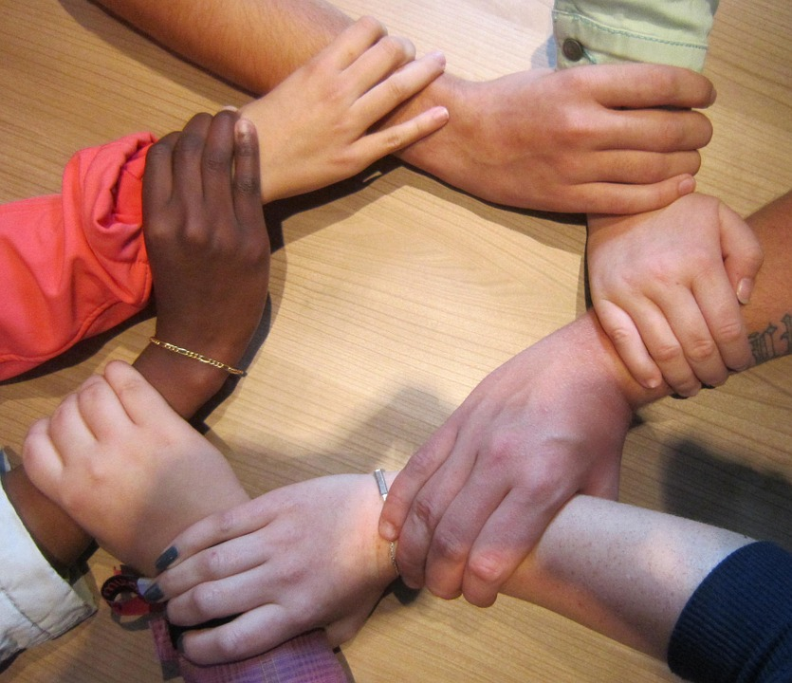
Holding the Cultural Context
Responsive and Respectful Care
Cultural Humility
A cultural humility perspective challenges us to learn from the people with whom we interact, reserve judgment, and bridge the cultural divide between our perspectives, in order to facilitate well-being and promote improved quality of life.
Cultural Responsiveness
The ability to learn from and relate respectfully to people from your own and other cultures.
Notes:
Cultural Humility: Such a perspective frees the observer from having to possess expert knowledge in order to maintain knowledge-based power, control, and authority over matters about which diverse populations are far more knowledgeable.
For supervision -- Transformative learning is often described as learning that changes the way individuals think about themselves and their world.
Transformative learning theory believes that change comes about through a process of dialogue and critical self-reflection.
This theory asserts that personal change is based on a deeper understanding of one’s own culture, values and history.
Transformative learning understands change to come about as a process of disrupting old patterns of meaning and creating new understanding of themselves and the world. Motivation to change behavior follows from the new understanding.

Slide 41

Example: Ken
Ken is a 9-year-old boy whose family immigrated from Korea two years ago. He is struggling with a mood disorder (depressed mood, low energy, he does not find pleasure in any activities he used to enjoy, he no longer spends time with his friends). Ken was referred by the school counselor and the family has brought along a cousin who the family has asked to act as a translator for the intake session. Before the meeting, the translator informs you that the family is uncomfortable with receiving services and believes that their son’s problems are not related to mental health, but that he is not trying hard enough to do well in school and make friends. He asks that you do not ask any mental health questions or use any mental health terminology during the intake. Additionally, he passes on a request from the family that you write a letter to the school letting them know that their son does not have any mental health problems/diagnosis.
How do we use our understanding of culture in this vignette think about Ken and his family?
How would you rate CG Knowledge?
Notes:
How do we use our understanding of culture in this vignette think about Ken and his family?
How would you rate CG Knowledge?

Slide 42
#5. The ratings are agnostic as to etiology; it’s about the What, not the Why.
When rating items, it is important that we focus on the behavior – the What. The reason for the behavior is not the focus during assessment, and it sometimes gets in the way of being able to identify needs.
The Why or the reason for the behavior will be brought in during the planning process.
Notes:
Only 1 item-Adjustment to trauma-cause effect judgment
The why comes later when we do action planning
Only interested in what is going on when you rate, later you talk about the why when it comes to intervention planning

Slide 43

Example: Tom
Tom, an 11-year-old, has some school behaviors that are significantly interfering with his functioning. He was rated as a ‘0’ on School Behavior because:
he has ADHD and cannot sit still
he does not want to be in school and is intentionally trying to get kicked out
he is being bullied and the teacher is responding to the child’s response to the bullying
because he reminds the teacher of someone she did not like last year and she is purposefully triggering the child’s behavior.
Is this an accurate rating?

Slide 44
#6. Use a 30-day window in considering what is relevant to children, youth and their families.
When the behavior happened, or its occurrence, is not the focus, but rather the current relevance of the behavior for the young person and/or the family.
Notes:
Only 1 item-Adjustment to trauma-cause effect judgment
The why comes later when we do action planning
Only interested in what is going on when you rate, later you talk about the why when it comes to intervention planning

Slide 45

Example: Jenny
Jenny is a 17-year-old youth and is in foster care. Jenny has a history of extensive methamphetamine abuse that contributed to some illegal activities. She has been clean and sober for two years.
How would you rate Substance Use for Jenny currently?

Slide 46
Nevada CANS 2.0
Describing the Domains and Items

Slide 47
Notes:
Take break/Lunch, then start up with this after break
From page 11 of the Reference Guide.
Help to inoculate people on the CANS. Are there any domains that you don’t already collect information on as part of your assessment process? What about items?
Go over the TRIGGER ITEMS and how this works with Modules.
There are 8 domains, 84 items….
Talk about early childhood module and supplemental modules

Slide 48
Notes:
Make sure that the participants understand when to complete the Transition to Adulthood Domain, and HOW to complete the CANS for Early Childhood.

Slide 49
Potentially Traumatic/Adverse
Childhood Experiences
Items are static indicators and identify whether or not a youth experienced the particular trauma/adverse life event.
These items ensure communication about critical experiences that may impact the youth’s behavior and support trauma-informed practices
Overall question to consider: Has the youth experienced adverse life events that may impact his/her behavior?
Notes:
Go over the TRIGGER ITEMS and Identify the Modules that are triggered.
Go over items that tend to be problematic or confusing.
Go through each domain, don’t go through every item
Go through ones that people have problems with,
Maybe go through 7 of them
NTCSN
Victim/witness to criminal activity—mom may do drugs but if vignette doesn’t say kids witnessed, then it is not a ‘yes’
Does anyone have any questions about items
Ok, so now practice

Slide 50
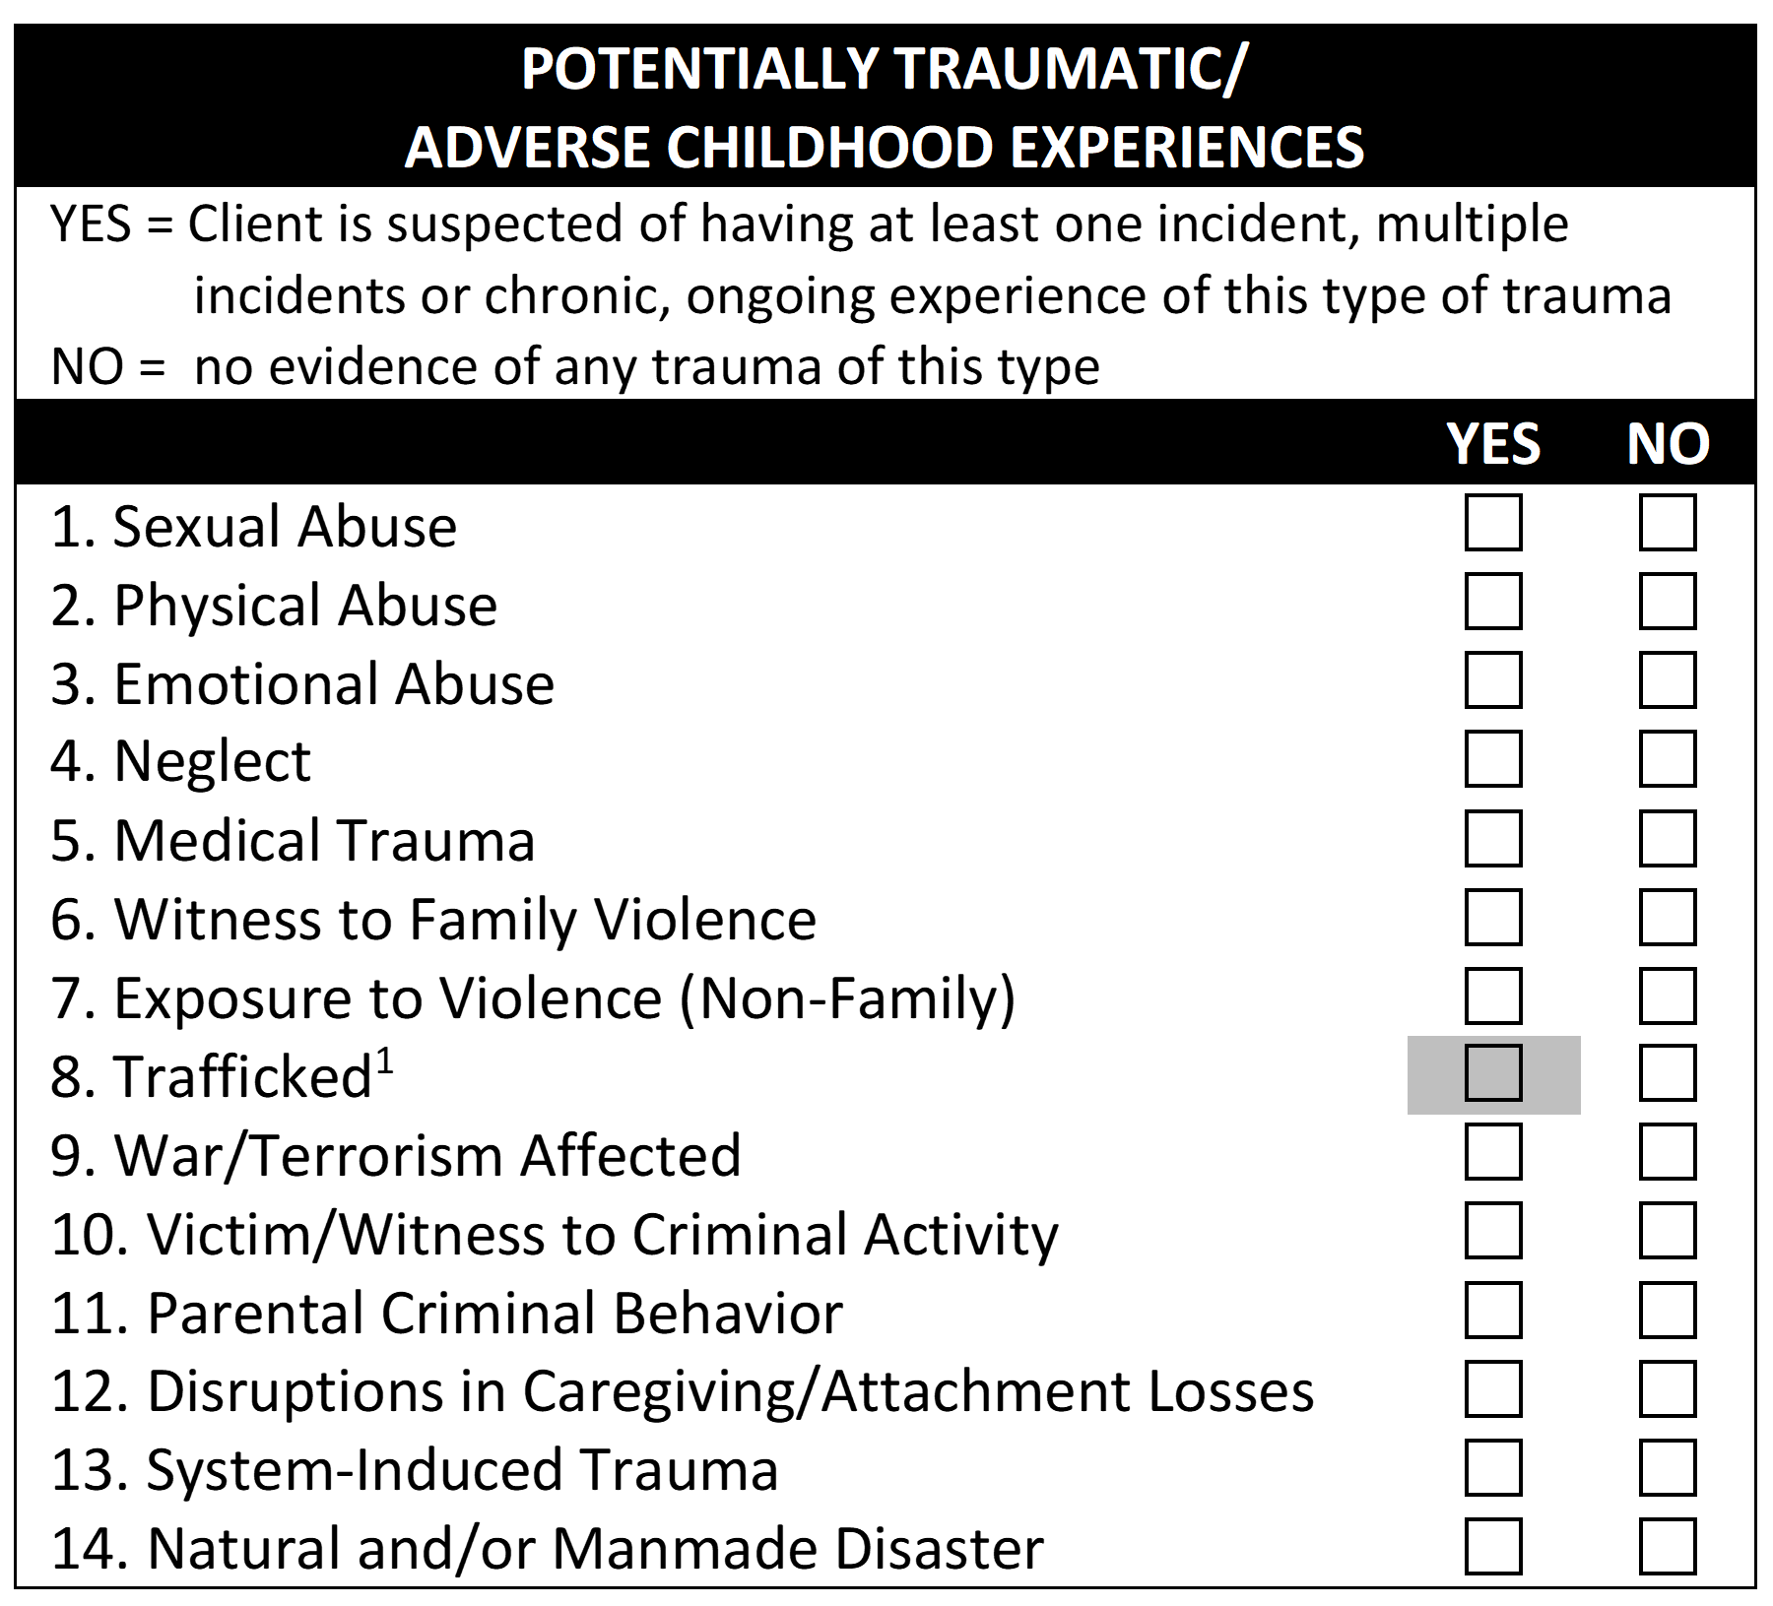

Practice: Potentially Traumatic/Adverse Childhood Experiences
Manuel is a 13-year-old Hispanic male currently living in a group home. Manuel is the middle child of 7 siblings, and his parents are married and live together. All 7 children were removed from the home due to allegations of physical abuse from Maria (mother) towards Manuel. The home was reported to have rotten food in the kitchen, piles of dirty clothes, and feces smeared in the bathroom. Manuel was forced to sleep outside on a mat due to his encopresis and enuresis which began after his first removal from the home. CPS is concerned about placing Manuel back in the home due to her inappropriate discipline and negative view of him.
Notes:
These mini vignettes are to help participants get used to vignettes.
Have the participants identify the trauma exposure items. There may be other items from other domains noted here, but focus on the trauma items.
For other domains – do not get hung up on the rating, as often there is not enough information to truly rate the item. Instead, focus on what questions they would ask that would help them get to a clearer rating.
Domain level vignettes from newly certified people
DO NOT get involved in discussing specific ratings, Point is for them to get familiar with items that they will have to rate
Make sure they have scoresheet they can use
Physical Abuse
Emotional Abuse
Neglect
Disruptions in Caregiving/Attachment Losses
System-Induced Trauma

Slide 51
Child Behavioral/Emotional Needs
This domain identifies the mental health needs of the children.
These items suppport a diagnosis but are not diagnostic
Overall question to consider: What are the presenting social, emotional, and behavioral needs of the youth?
Notes:
Go over the TRIGGER ITEMS and Identify the Modules that are triggered.
Go over items that tend to be problematic or confusing.

Slide 52
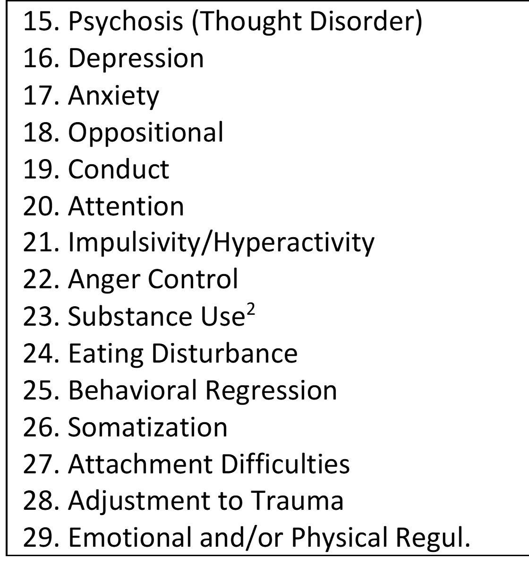
Practice: Behavioral/Emotional Needs
Manuel has been diagnosed with ADHD and is taking medication that does not seem to help with his impulsivity. Manuel does get into fights at school for being bullied for his accent. He also has a history of stealing from other children in the group home and from his family as retaliation. He has difficulty following the rules, completing chores, and cleaning up after himself when he has soiled himself. Manuel has extreme tantrums when he is told no or asked to do things he doesn't want to when on home visits.
Notes:
Attention
Behavioral Regression
Impulsivity/Hyperactivity
Oppositional
Anger Control
Attachment Difficulties
Emotional and/or Physical Regulation

Slide 53
Life Functioning Domain
This domain rates how the youth is functioning in the individual, family, peer, school, and community realms.
Highlights any struggles/needs the youth and family are experiencing
Overall question to consider: How is the youth functioning in the individual, family, peer, school and community realms?
Notes:
Go over the TRIGGER ITEMS and Identify the Modules that are triggered.
Go over items that tend to be problematic or confusing.

Slide 54
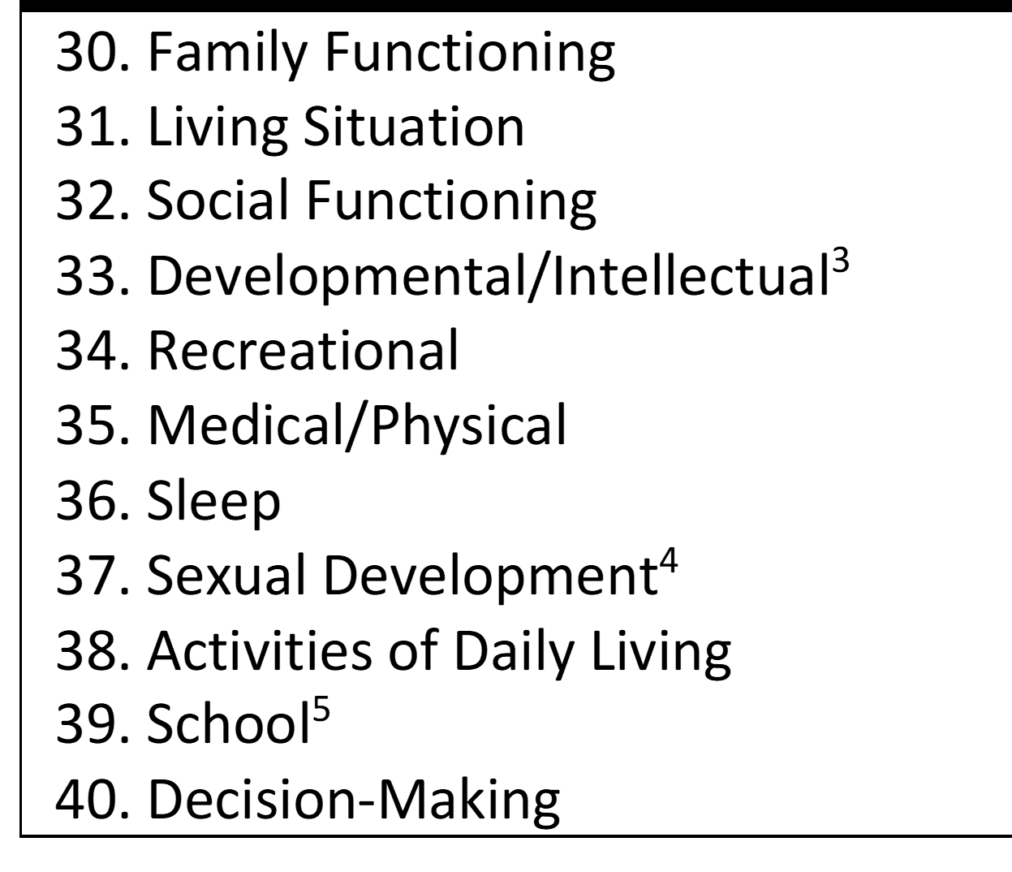
Practice: Life Functioning
Manuel has a strained relationship with his mother. She tends to avoid spending time with him and blames him for most of the problems in the home. He currently lives in a group home. Manuel does poorly in school. He often gets into fights due to being bullied for having an accent. He does, however, have some friends and enjoys spending time with them playing video games or going to the park.
Notes:
Family Functioning
Living Situation (group home)
Social Functioning
School
Recreational

Slide 55


Slide 56
Risk Factors & Behaviors
Identifies behaviors that may put the youth at risk for serious harm to self or others
The time frame in which the youth engaged in the risk behaviors is critical to determining the level of need. Many items in this domain include specific time frames within the definitions.
Overall question to consider: Do the youth’s behaviors put him/her at risk for serious harm to self/others?
Note: these items do NOT replace a detailed risk assessment
Notes:
Go over the TRIGGER ITEMS and Identify the Modules that are triggered.
Go over items that tend to be problematic or confusing.

Slide 57
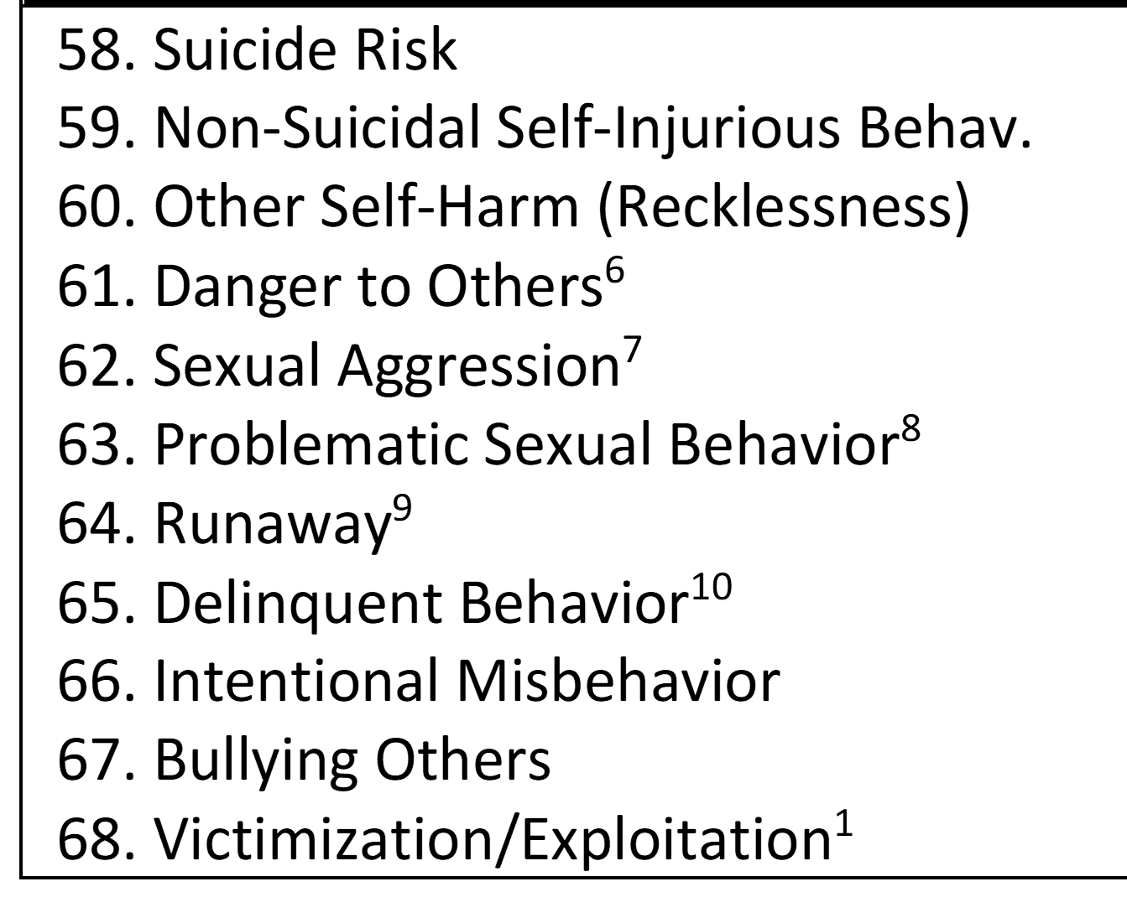
Practice: Risk Factors & Behaviors
Manuel does not have current or history of suicidal ideation or self-harm behaviors. While Manuel has a history of stealing items from peers when he is angry with him, he has never been arrested for this theft. Manuel does have a history of aggression toward other including fighting with peers at school. After one particularly bad fight with his mother, Manuel left the house and didn’t return for 36 hours. Sometimes when there are fights, he threatens to runaway again.
Notes:
Suicide Risk
Delinquent Behavior
Danger to Others
Intentional Misbehavior
Runaway

Slide 58
Cultural Factors
These items are designed to understand various cultural and acculturation aspects from the youth’s perspective to ensure meaningful communication and service planning
Overall question to consider: How does the youth’s membership to a particular cultural group impact his or her stress and well-being?
Notes:
Go over items that tend to be problematic or confusing.

Slide 59
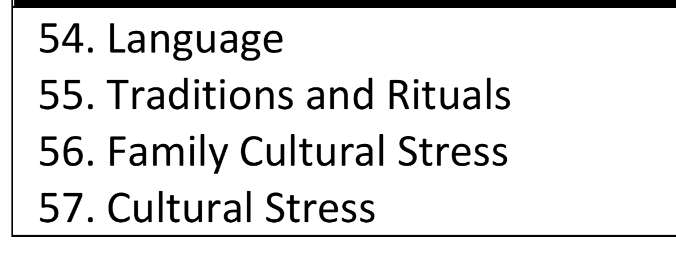
Practice: Cultural Factors
Manuel's father requires an interpreter and has difficulty finding a job due to being solely Spanish-speaking. Manuel has been bullied at school for having an accent. Manuel has home visits on all holidays and is able to participate in family rituals and traditions.
Notes:
Language
Traditions and rituals
Cultural Stress
Family Cultural Stress

Slide 60
Youth Strengths
Two types of positive, contextual, social and individual variables or strengths are identified that support the youth’s development: assets and resources.
Overall question to consider: What strengths does the youth have that can be used as a resource and what strengths can be identified to build?
Notes:
Go over items that tend to be problematic or confusing.

Slide 61
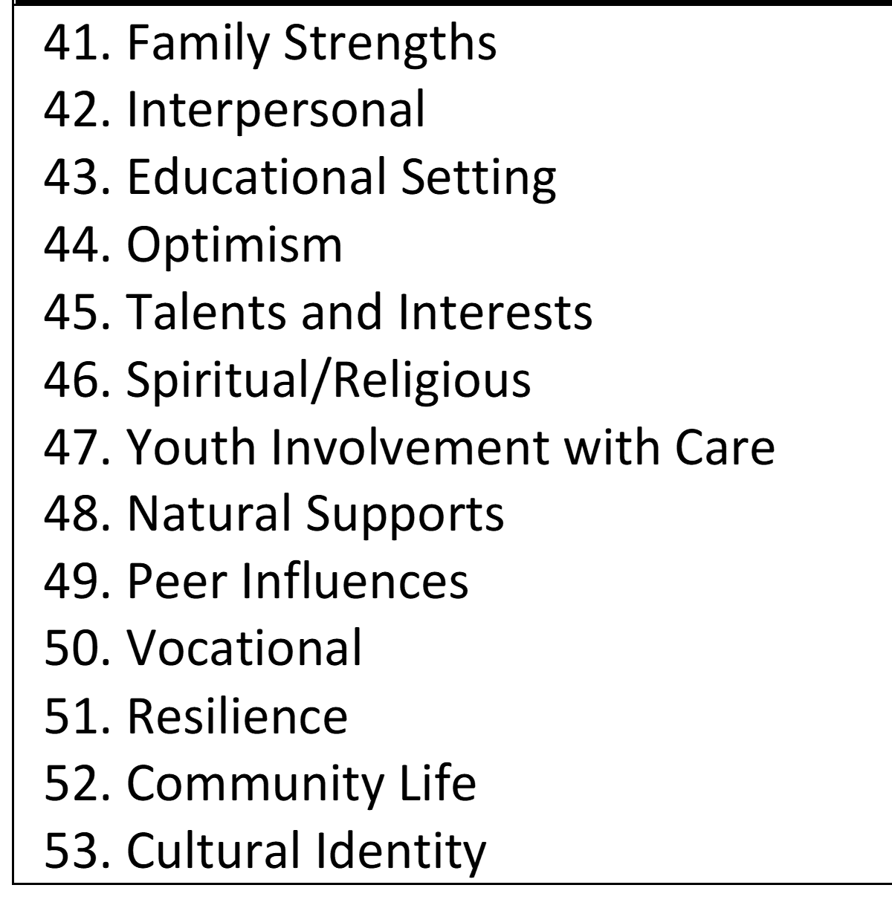
Practice: Youth Strengths
The school seems ill-equipped to handle Manuel's behaviors and often suspends him for several days at a time after getting into fights. Manuel is close to his father, who will often take him out for rides while he is home on visits. His father is more lenient than his mother and Manuel knows his father will always "save him." Manuel has played soccer in the past and is involved in the Big Brothers Big Sisters program. His big brother has been a support for the family. Manuel enjoys video games and thinks working with computers when he gets older would be a good career.
Notes:
Educational Setting
Community Life
Family Strengths (father)
Vocational
Optimism
Talents and Interests

Slide 62
Caregiver Resources & Needs
Potential areas of need for caregivers AND areas in which the caregivers can be resources for the youth
Caregiver(s) with whom the youth is currently living are rated
Overall question to consider: What are the needs of the youth’s caregiver?
Notes:
Go over items that tend to be problematic or confusing.
Go over how to rate the Caregiver Domain when there is only 1 section to complete and there are multiple caregivers – identify the caregiving system and identify the caregiver with the need on each item. Identify the caregiver with the need, along with the rationale for the rating.
Remember: If there are multiple children in a family, the Caregiver Domain must be completed for each child. The caregiving needs for a 17 month old are very different than for a 17 year old.

Slide 63
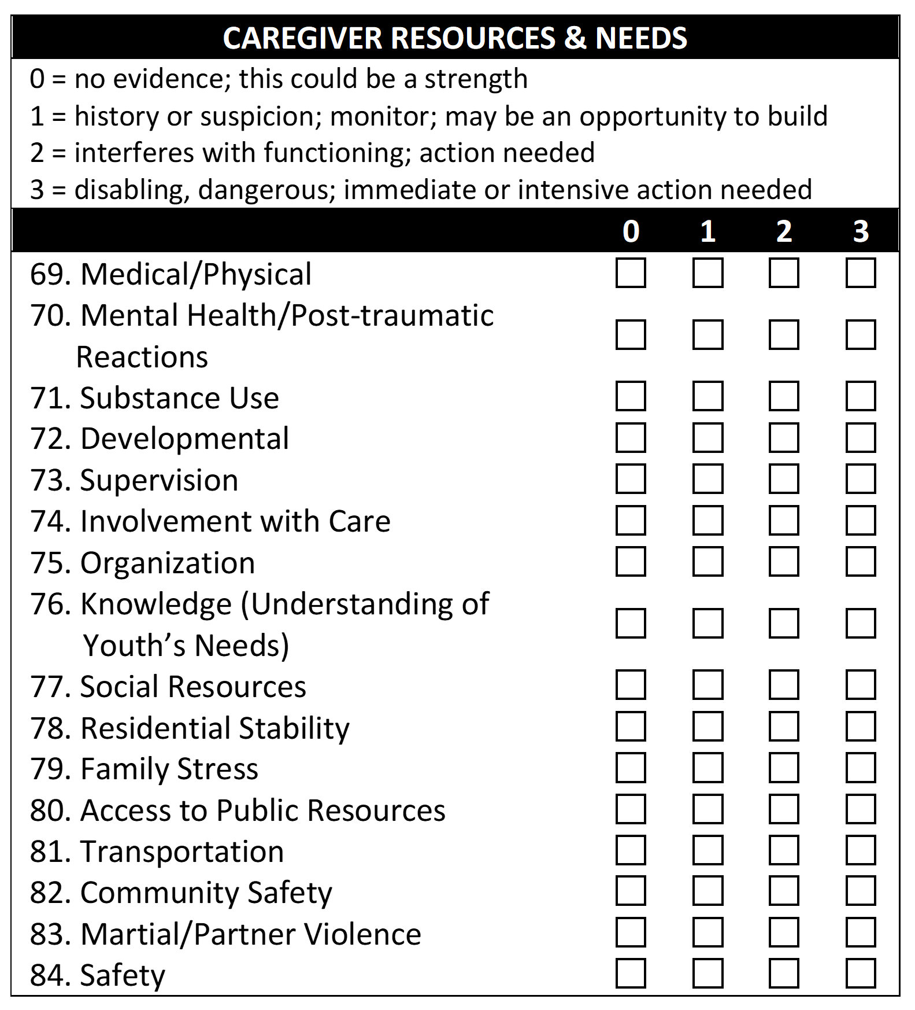
Practice: Caregiver Resources & Needs
Both of Manuel's parents are involved in his care and are participating in family therapy. Manuel's mother has expressed hesitancy about Manuel being back in the home due to her ability to supervise and discipline Manuel effectively. Manuel's mother blames him for the problems in the household and for the removal of all the children. Manuel was forced to sleep outside on a nap mat due to his toileting issues.
Notes:
Involvement with Care
Supervision
Knowledge
Family Stress

Slide 64
Nevada CANS 2.0 – Transition to Adulthood
Additional items specific to youth transitioning to adulthood: Youth ages 14+
Notes:
Go over items that tend to be problematic or confusing.

Slide 65
Practice: Transition Age Youth
Tracey is a seventeen-year-old living with her mother after running away and being sexually exploited for the past few years. Her mother recently lost her job and has no income. She recently had a baby girl and is very focused on caring for her, despite her admission that it is difficult. Tracey is also trying to get back into school as she sees her high school diploma as the first step in pursuing her dreams of becoming a medical professional and providing a better life for her daughter. She is, however, 2 years behind her peers in school, and is worried about how she will be treated given her recent life on the streets.
Notes:
Parental/Caregiving Role
Youth Educational Attainment
Independent Living Skills
Accessibility to Child Care Resources and/or Respite

Slide 66
Nevada CANS 2.0 – Early Childhood
For children birth thru age five (until child turns 6 years old.
Notes:
Go over items that tend to be problematic or confusing.

Slide 67
Practice: Early Childhood
Joey is a 27-month-old boy living with his mother, Lillian who is hearing-impaired. He is involved with Early Intervention (EI) services, and receives in home resource teaching, occupational therapy, and speech and language services. He has functional physical skills, but his physical therapy evaluation resulted in a recommendation that his mother involve him in community activities (playground play, local early years programs) to increase physical gross motor play opportunities and to give him experience with peers.
Joey is demonstrating moderate difficulty with self-regulation, moderate fine motor delays and moderate sensory sensitivities to tactile input affecting food preferences. Mom reports that Joey tantrums at meals sometimes (about 3 times a week) and that his tantrum can last up to 2 hours before he can calm down and be ready to play. When having a tantrum Joey becomes very aggressive and tries to bite, hit and/or kick Mom or other people around him. Joey’s OT and the resource teacher have taught Lilian calming strategies to help Joey with self-regulation, but report that Lillian has not been able to integrate them into her day-to-day routine and is not effectively able to reduce his tantrums.
Notes:
Family Functioning
Social and Emotional Functioning
Developmental/Intellectual
Language
Caregiver Emotional Responsiveness
Supervision
Involvement with Care
Knowledge

Slide 68

Practice Vignette
Understanding the link between ratings, rationale and reliability

Slide 69
Collaborative Ratings
Before rating an item, consider the following questions:
Is there any evidence of a need or strength?
Are you understanding the youth’s behavior within normal development given his/her age?
Have you considered the youth and family’s culture? Does your approach to assessment and engagement communicate respect for the youth and family’s culture?
Is the need impacting the youth’s functioning?
How urgently is action required on a need? How useful is the youth/family strength in achieving targeted outcomes?
Are you focused on describing the need and strength, and not the underlying cause?
What services are already in place for the youth and/or family?
Notes:
If used in a team, CFT
To get consensus and collaboration

Slide 70
Tips: Rating CANS Items
When you are having trouble rating items:
Read the description of the item to make sure you understand it.
Get more information – talk to the client, caregiver or other providers; review records and charts.
Determine the impact on functioning of the need and the intensity of action that you need to take to address the need.
Use the rating level anchors for each item, if they are helpful (remember – the anchors are not going to describe every possible situation).
Rate the items collaboratively with clients, families and the treatment team. This will help you understand the story and develop a shared vision with the client, family and team.
Notes:
If used in a team, CFT
To get consensus and collaboration

Slide 71
Why Practice Vignettes?
Provides an opportunity for a deep dive into understanding the communimetric principle of actionable items.
Discussions on vignettes and ratings:
  helps us understand how our assumptions on a case impacts how we see a youths’ needs and strengths.
  provides us with an opportunity to practice surfacing disagreements about our perspectives on youths’ needs or strengths (pre-rating triangulation).
Helps us understand that establishing reliability is not separate from our process of relating to, and working with our children, youth, adult and family clients.
Notes:
Pre-rating triangulation: Getting all the important information from all the relevant/available sources before making a rating. The rating is done in consultation with the client and family. This is the heart of therapy: building and acting on a common understanding (and is why the collaborative assessment process is associated with better engagement and a small treatment effect).
The CANS is designed to help people get through the toughest, most stigmatizing part of disagreement: the ‘why’. It does this by allowing you to build a sense of Why Something is Happening together with the client.
The more we make the ratings about their action implications, the more useful and reliable they become.

Slide 72
Tips: Rating a Vignette
Completing a practice or test vignette can be very frustrating:
If there is no information in the vignette related to a particular item:
    Rate the NEED "0" (NO NEED)
    Rate the STRENGTH "3" (NO STRENGTH)
Take the vignette literally—DO NOT over think, make any assumptions or add extra information (from your knowledge base or experience) into the vignette.
Review the Needs and Strengths tip sheet.
Notes:
If used in a team, CFT
To get consensus and collaboration

Slide 73

Enzo Vignette
Enzo is a 15-year-old boy who is currently in foster care. Enzo is Latino, his mother is Puerto Rican, and his father is Dominican. Enzo and his two siblings were removed from their parents due to serious neglect and placed in care six years ago because their parents both were substance abusers and involved in criminal activity; their parents’ rights were terminated two years later after they failed to comply with court-ordered drug treatment. Enzo’s older brother is 22 and is living independently; he visits with Enzo at least once each week. Enzo’s younger sister was adopted by a previous foster family and Enzo does not have any contact with her.

Slide 74
Until about one month ago, Enzo believed that his biological parents were dead. His older brother told Enzo and his sister this when parental rights were terminated, in an attempt to help the children, heal and connect to their foster parents. During a visit last month, however, Enzo’s brother told him that their parents are alive, and that Enzo’s mother is sober and would like to have contact with Enzo. Enzo and his brother are close, and Enzo feels some pressure to resume contact with his mother because of his brother’s wish to reunite their family.
Enzo currently lives with pre-adoptive foster parents, Karen and Daniel. He has lived with them since being discharged from a residential treatment center two years ago. Prior to this foster home placement, Enzo was in several different foster homes, was admitted to inpatient psychiatric hospitals three times, and ultimately placed in a residential treatment center for stabilization. Enzo’s placements were disrupted by – and his inpatient admissions precipitated by – severe oppositional behaviors, anger control issues, and incidents with foster parents and peers that included physical violence. He did well with his current foster family until recently, however, and was doing well in school, behaving at home, and had expressed his interest in being adopted by Karen and Daniel, who have long hoped to adopt Enzo.

Slide 75
Karen and Daniel both are first-generation Dominican Americans. They express that they care deeply for Enzo, and that it means a lot to them to be able to adopt a boy who is Dominican. They maintain strong, mutually supportive connections with other members of the Dominican community and have tried to teach Enzo about the importance of family in Dominican culture and about Dominican arts, cooking, and culture. Enzo has shown a great interest in these issues and regularly attends Dominico-American Society events with them. Up until this month, Enzo reported to his therapist that he strongly identified with Dominican culture and that he was glad he was going to be adopted by a Dominican-American family. About two weeks ago, Enzo became angry and postured aggressively toward a peer at one of the events and Board members gave him a warning about his behavior.

Slide 76
After he found out his mother was alive, Enzo began acting out. He has been staying out after school and coming home late and after the town curfew, refusing to do his homework or chores, being argumentative, and saying that he does not want to go to community events with his foster parents. On two occasions in the past two weeks, Enzo became so angry in response to being confronted about his homework that he threw his schoolbooks across the room. Last week, he told Karen and Daniel that he no longer wants them to adopt him, and they should send him back to his mother. Karen and Daniel are very upset and somewhat stressed by Enzo’s statements; they have come to care deeply for Enzo and fear that his mother’s presence in his life will lead to them losing the boy. They are willing to do what it takes to help Enzo cope with his reactions but do not feel that he should have regular contact with his mother.

Slide 77
Enzo is currently placed in a specialized classroom because of his history of oppositional behaviors and poor peer relationships in school and a documented learning disability. Enzo was doing average work in this class, and behaving well with intensive support, until he found out about his mother. This month, he has stopped doing his homework and his classroom work, is failing all his tests and quizzes, and has been disruptive and disrespectful in class; his teachers are so frustrated with his behavior that they are not open to helping him. Last week, he got into a fight at school and was suspended; he now says he wants to drop out of school.
Enzo has shown a long-term interest in hip hop music. Despite his current stressors, he continues to enjoy hip hop. He sought out and attends an afterschool program at a local community center where professional musicians work with children and help them write and record their own songs. Enzo recently won first place in a competition for lyrics when he sang three of his own songs. Enzo continues to write and to rap at home, and says he thinks he may be able to become a famous rapper someday.

Slide 78


Slide 79

Certification Test
Certification Test: TCOMtraining.com
For Training Coupons: AGuevara@dcfs.nv.gov
Notes:
Put in packet we hand out

